Slide 1
Sexual Reproduction in Plants

Slide 2
By the end of this Smart Lesson you should be able to:
1. | Explain how plants undergo sexual reproduction.
2. | Name all the female and male sex organs in plants.
3. | State the functions of each sex organ.

Slide 3
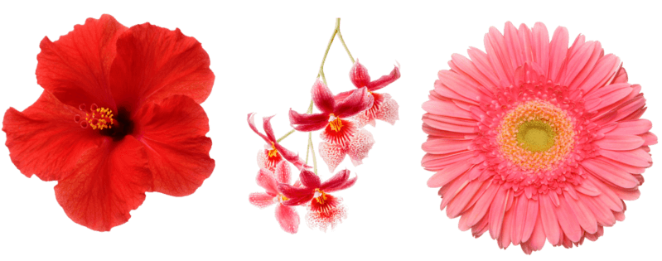
Sexual Reproduction
Sexual reproduction produces offspring that are different to their parents. This introduces variety, which can be advantageous in a changing environment.

Slide 4
Adaptation is good for survival of a species
If offspring are different, some may be more adapted to challenging conditions and will survive to produce more offspring. In this way, the species survives.

Slide 5
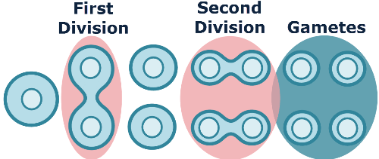
Sexual reproduction requires gametes
Sexual reproduction involves specialised gametes, which are produced via meiosis.
Meiotic daughter cells (cells produced by meiosis) inherit half of the genetic information (DNA) from the parent cell (the cell that divided to create the two daughter cells).
Don't worry too much about this process, you will learn more about it next year!

Slide 6

The goal of sexual reproduction
The aim of sexual reproduction is to combine the male and female gametes to produce a cell with a full copy of genetic information (the zygote).

Slide 7
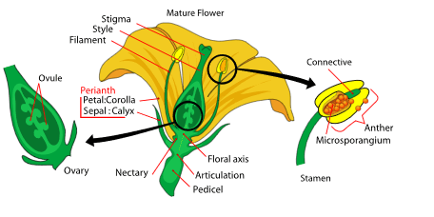
Flowers are often the reproductive organs in plants
Flowers are a common organ in plants used for sexual reproduction. Some flowers have both male and female parts, while others only have one or the other.
The image below labels some reproductive structures, like the anther and ovary. You will learn about these during this Smart Lesson.

Slide 8
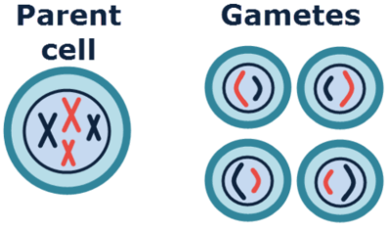
Role of the flower in sexual reproduction
The role of the flower in sexual reproduction is to produce gametes, bring these gametes together, and then to disperse the resulting, fertilised seed.

Slide 9
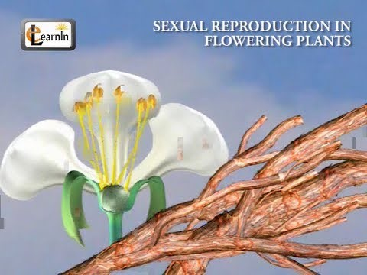

Slide 10
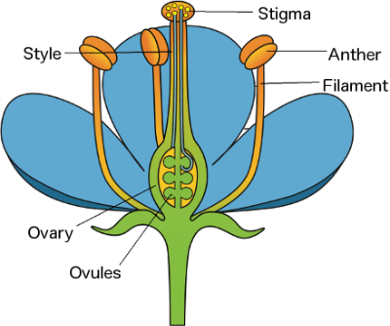
The diagram below labels the sex organs of a plant:

Slide 11
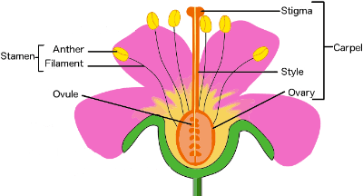
The male part of the flower
The entire male part of the flower is the stamen. It is composed of the anther and the filament.
Anthers are where pollen is made.
Fun Fact: The number of stamen is usually the same as the number of petals.

Slide 12
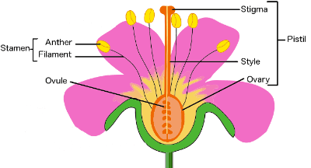
The Anther
The anther is the part of the stamen that produces and contains pollen. It is usually on top of a long stalk that looks like a fine hair.

Slide 13
The Filament
The filament is the fine hair-like stalk that the anther sits on top of.

Slide 14
The female part of the flower
The entire female part of the flower is the carpel. It is composed of the stigma, style, ovary and ovules.

Slide 15
Carpel
The carpel is the female part of the flower. It is made up of the stigma, style, and ovary.

Slide 16
The Stigma
The stigma is one of the female parts of the flower. It is the sticky bulb that you see in the centre of the flowers.
It is the part of a flower which receives the pollen grains and on which they germinate.

Slide 17
The Style
The style is another female part of the flower. This is the long stalk that the stigma sits on top of.

Slide 18
The Ovary
The ovary is the part of the plant, usually at the bottom of the flower, that has the seeds inside and turns into the fruit that we eat. The ovary contains ovules.

Slide 19
The Ovule
The ovule is the part of the ovary that becomes the seeds.

Slide 20
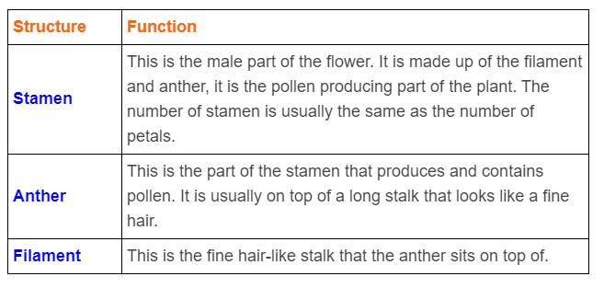
Male parts of flower:

Slide 21
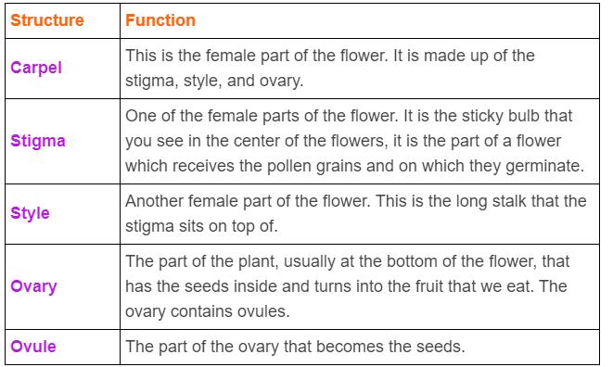
Female structures of the flower:

